Slide 1
Exascale, Quantum, Review

Slide 2
Exascale, Quantum
There isn’t really a lot to say about exascale computing, basically it’s what we’re doing only bigger/smaller/faster
Quantum is it’s own thing. It’s a fundamentally different model of computation, and data representation… and really it warrants its own course when/if we ever get there

Slide 3
Looking towards Exascale Computing
Projected for 2023 (US); maybe earlier for China
Exascale Hardware Systems
Achieving 10¹⁸ flops sustained
Billion-way parallelism required
Requires dramatic improvements in power efficiency – 20 Megawatts
Retaining resiliency in the presence of faults
Scalable Parallel Programming
X-10
Chapel
XPI
Hybrid programming: MPI + X
Runtime Software Systems
Exploits runtime information and dynamic control for efficiency and scalability
ParalleX/HPX
UIUC – Charm++
Rice University - Open Community Runtime (OCR)

Slide 4
Clusters
Lawrence Livermore national lab is expecting to have their next supercomputer El Capitain up and running in 2023 ish with 2 exaflops of performance (AMD EPYC CPUs with 4 Radeon GPUs/CPU) ~40MW
Oak ridge is setting up 29MW supercomputer that will likely be exascale too
Both are for modelling nuclear bombs (and related tech)
Japan/Fujitsu has a 0.4 exaflop (1.4 peak) computer running now on ARMv8. It does weather
China (PRC) – will have Tianhe-3 before 2025 (Based on ARM, in the prototype stage, heavily into AI/Deep Learning for now)
China also appears to have two super computers (for bombs) that they aren’t publicly benchmarking
EU – has a plan for 2022/2023
India- the Indian Institute of science (Sri’s Dad’s alma mater) is developing their own microprocessors for an exascale computer. It’s probably going to be late

Slide 5
MPI+X
So MPI can scale to millions of nodes already. Scaling to billions you might run into addressing calculation problems or the like but at this point these are solved problems that would be minor version changes
Main problems:
Connection management
Buffer management
Memory Footprint
Fast collective operations

Slide 6
MPI+X
Most likely the specification will evolve to more cleanly support streaming technologies for GPUs
Something like MPI + OpenACC but in one standard and with a sensible way to manage that
May also see more user control of how communication and buffers are managed since the problem here is really the different hardware and architectures used aren’t well accounted for by MPI

Slide 7
https://wgropp.cs.illinois.edu/bib/talks/tdata/2017/HPCF-mpix-exascale.pdf
Interesting talk slides if you’re interested (it’s not that important and pretty technical though)

Slide 8
Storage
We’re looking at some complex changes going forward
First – platter drives are getting absurdly huge there are reasonable plans for 30TB drives in the next couple of years (considering you can buy 16 TB now that’s fine).
Beyond that we’re going to need HAMR (heat assisted magnetic recording). WD has been planning 60 TB drives for around 2026 since 2013.
Basically: Heating a disk when writing means you can use weaker fields and pack them more densely.

Slide 9
SSD Storage
The thinking is that eventually transistors will become smaller/cheaper than magnetic fields on platters
At which point flash memory (SSDs) will be cheaper per bit than HDDs and significantly faster.
It may also be that the performance/cost difference gets so good that it’s not worth using HDD’s except in the way we use tape.
I’d be worried that HAMR HDD’s will have poor long term storage characteristics.

Slide 10
Filesystems (well, volume/HDD managers)
Things like ZFS scales to absurd sizes and performance already
But – the big things:
deduplication performance
Software level awareness of drive architecture/caches (HDD’s have build in SSD caches).
I suspect this is conceptually not that exciting, so not much to talk about – at least until there is some radical shift in drive tech

Slide 11
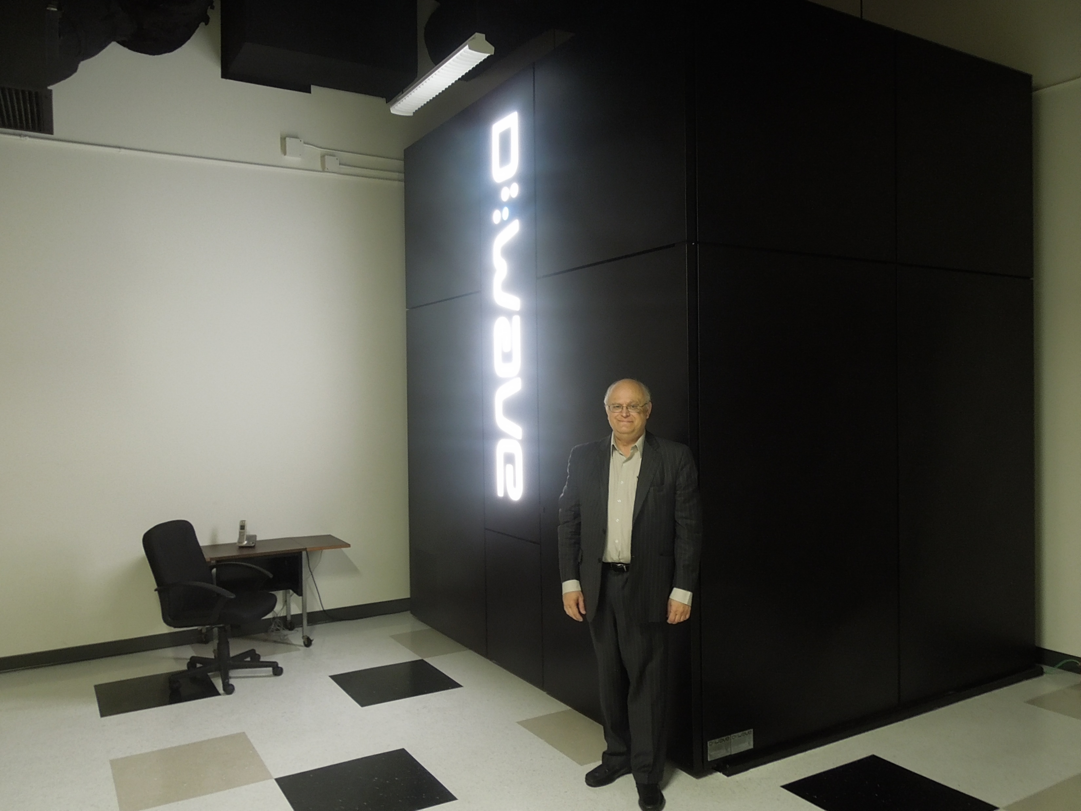
Beyond Exascale
Quantum Computing
Exploits quantum mechanics
Uses superposition, tunneling, entanglement
Might solve problems otherwise impossible
Still in research, but promising
Neuromorphic Computing
Brain inspired
Neural networks early example
Uses training sets in many cases
Superconducting Supercomputing
Josephson junctions for quantum flux gates
Potentially 100’s of GigaHertz clock rate
Processor in Memory (PIM)
Merges logic at sense amps of memory
Reduces latency, increases bandwidths
Notes:
Josephson junction: put two superconductors near but not next to each other. Electrons tunnel through the material (different ways for different materials). These form a step function. The trick is that this tunnelling and step function change can happen insanely fast because these are super tiny.

Slide 12
Processor in Memory
Also called computational ram now
This is where ram and the CPU are fabricated on the same process and essentially one chip. (Think CPU cache, but like… RAM capacity)
This would dramatically cut memory latencies, meaning you could get much more utilization out of processors and much higher performance for embarrassingly parallel data problems
The manufacturing process for DRAM and CPU’s are different (layers vs no layers etc.) so merging them is relatively complex but if it can be done, cool stuff happens.
Ironically, this was something common in the 1960’s and then the production methods separated.

Slide 13
Superconductor computing
You can make junctions between superconducting materials, make that into a transistor and boom: insanely fast transistors
Assuming you can get the superconductor part to work at reasonable operating temperatures

Slide 14
Computational RAM + Superconductors
One would reasonably expect to need new software to take advantage of some of this
But really it’s still bits and bytes and you can have ISA compatibility with existing architecture.
What you’d likely see is expanding or new APIs that account for lower memory latencies and much higher bandwidth/throughputs
That’s not a huge challenge intellectually. If you can go from 1MHz to 1GHz going from 1GHz -> 100GHz isn’t some insurmountable problem.

Slide 15
Neuromorphic Computing
Basically, trying to build chips to be architected like brains
This assumes brains are sensibly wired, but the thinking is that our brains do really cool stuff really fast so it must be right
Essentially: Imagine if you architected a CPU+memory like a neural network

Slide 16
Quantum Computing
What if a bit wasn’t a 1 or a 0, but a quantum superposition of states 0 and 1, with each bit having a probability of being each particular bit
store a ‘bit’ in a quantum state (electron ‘spin’, excited electron states, light polarization, trapped ions, superconducting circuits in clockwise/anticlockwise arrangements, that sort of thing)
Once you have a quantum bit, you then transform the bit according to some computation – essentially just have some data in quantum memory transform it into the calculated result
Quantum bits are particularly handy for encryption and solving Fourier transforms

Slide 17
Biological and Quantum Computers
These will likely require entirely new technology for computation
You probably can’t just recompile some code to work on a whole new model of computation, nor could you make an ARM- Quantum Computer sort of thing
(You could do ARM + quantum, or x86-64 + quantum I guess)

Slide 18
Review

Slide 19
Exam
1 page cheat sheet, anything you want, both sides, letter or A4 size. No questions require a calculator
11 questions + bonus. One question is worth twice what the others are (so 60 marks total).

Slide 20
Q1 General HPC Stuff
What do we use HPC for?
What types of numerical methods (names/types not how to do them)
How have advancements in HPC progressed to regular computing?
What are the main models of computation (SISD, SIMD, MISD, MIMD, sometimes called Flynn’s taxonomy)

Slide 21
Q1 continued
I’m not hugely interested in the specific history of computing (or super computing for that matter)
But you should be able to see that certain innovations, particularly since the 1960s have become commonplace. Parallelism, superscalar execution, SISD, SIMD, MIMD, message passing, energy efficiency, threads, pipelines, software etc.

Slide 22
Q2: Performance Measures
The broad challenge of benchmarking and performance analysis is ‘what is the right way to evaluate it’.
E.g. with a network you have overall throughput, frequency bandwidth used, number of possible channels, latency, jitter, number of hops, reliability, error rate and probably more. (That level of detail is COIS 4310H: computer networks, specific)

Slide 23
Q2: Continued
We talked about many components, including network interconnects within a supercomputer (so from the previous slide things like hops, frequency bands used, are probably not important)
So what metrics would we use? What measure do they have.
Networks and file systems (and buses) can measure throughput in m/G/T bytes per second for example, latency in milli/micro/nano seconds
CPU’s and GPU’s might have core counts, types of cores, but those really lead us to instructions per second, flops, that sort of thing.

Slide 24
Q3: Resource Management and Job scheduling
The previous question considered what resources there are and how you asses their performance
Another problem to think about is how do you manage those resources? (And which ones are the relevant ones to manage, and at what level)?
HPC we tend to think about managing jobs, though individual components still have operating system level queues and so on (more on that later)

Slide 25
Q3: Continued
In class (and on an assignment question) you looked at what various job schedulers do
So what resources do they schedule, and why/how?

Slide 26
Q4: OpenMP vs MPI
Q4 is a high level theory question on MPI vs OpenMP
Which is more suited for a particular problem and why (it’s not a trick question)

Slide 27
Q5: More OpenMP vs MPI
Programming questions, 10 marks (all other questions are 5 except the bonus)
You don’t need to write working code, or even real code, pseudo code or a description of what the code would do is fine.
It’s easier than the labs/assignments
Two problems, do them both in OpenMP and MPI

Slide 28
Q6: Parallel Algorithm
This is a high level parallel algorithm question
You need to describe the algorithm, and it’s very similar to a problem we looked at in one of the labs
It’s not OpenMP or MPI specific, and there are several possible solutions.

Slide 29
Q7: Challenge problem
In Q7 give you a description of a real simulation/modelling problem and you need to develop and modelling method that will handle it
This is a parallel algorithms problem (But it’s embarrassingly parallel), you just need to think about the best way to model the parallelism, because it can be done several ways

Slide 30
Q8: OS Resource Management
In a previous question there’s stuff about Job level management (aka application level), where you have users trying to run jobs that need some number of cpus, gpus, etc.
But we also have lower level resource management at the OS level

Slide 31
Q8: continued
Say you have 2 running jobs, both need to send data on the network, how does the OS allocate the network resource between jobs?
How does the OS manage starvation (or to a lesser extent, deadlock)?
Which resources does the OS need to manage? How are those managed?
(Some of this is the same problem as a desktop OS these days)

Slide 32
Q9: Accelerators
We didn’t do anything practical with GPU acceleration, even though that is maybe sort of possible with terrible integrated laptop GPUs
How are accelerators architecturally different than CPUs? How is the programming model of threads/processes different from the GPU versions (gangs workers vectors).
How do you divide up jobs on an accelerator differently than dividing it up on a CPU?

Slide 33
Q9 Accelerators
Given a (simple) problem how would you divide it up based on what we know of Accelerators?

Slide 34
Q10: Storage and file Systems
Two parts to this question, and specifically I mean mass storage, not RAM.
There’s bit on storage technology (think tape/platter/solid state/optical storage)
I’m not looking for detailed engineering analysis, but you should know different types of use cases for the different types of storage

Slide 35
Storage and File Systems
The second part of the question is about file system for distributed systems
What are the key differences between a cluster OS and a desktop one? (E.g. fault tolerance, account separation, concurrent users, that sort of thing)

Slide 36
Q11: MapReduce
What is the map reduce paradigm?
We didn’t really talk about it, but MapReduce is easy to use, it’s not necessarily the most efficient way to do many things we can do well with databases, so don’t overthink this
Given a sample problem (that is related the ones in the notes) can you explain how a MapReduce would work?

Slide 37
Q12: Bonus
Joke Question.
Marks based on the humour of your answer
Bonus marks will not let you exceed 100% on the exam.

